Slide 1
Introduction
CS 1301

Slide 2
Outline
1. Computer Organization
2. Machine Languages, Assembly Languages,
and High-Level Languages
3. Program Solving Cycle
4. Program Components
5. Introduction to Java (Why Java?)
5.1 History of Java
5.2 Some Characteristics of Java 5.3 Java programs
5.4 Java Editions
6. Java and a Typical Java Development Environment
7. Program Compilation
6.1 Java Program Compilation
6.2 Java Virtual Machine (JVM)
8. Difference between Java and C++
9. Program Testing & Debugging

Slide 3
1. Computer Organization
A computer consists of:
Hardware: Physical devices of computer system
Software: Programs that run on computers
A program is a set of instructions written in a high programming language (such as C/C++ or Java) to do a specific task.

Slide 4
1. Computer Organization (Cont.)
The main components of a computer system are:
1. Input unit (mouse, keyboard)
2. Output unit (printer, monitor, audio speakers)
3. Memory unit (retains input data, calculated data and instructions)
4. Central processing unit (CPU) which consists of:
4.1 Control unit (supervises the operation of other devices)
4.2 Arithmetic and Logic unit (ALU) (performs calculations)
5. Secondary storage (hard drives, floppy drives)

Slide 5
2. Machine Languages, Assembly Languages and High-Level Languages
Programmers write instructions in various programming languages, some directly understandable by computers and others requiring intermediate translation steps.
These may be divided into three general types:
Machine languages
Assembly languages
High-level languages

Slide 6
2. Machine Languages, Assembly Languages and High-Level Languages (Cont.)
Any computer can directly understand only its own machine language, defined by its hardware design.
Generally consist of strings of numbers (ultimately reduced to 1s and 0s) that instruct computers to perform their most elementary operations one at a time.
Machine dependent—a particular ma-chine language can be used on only one type of computer.
English-like abbreviations that represent elementary operations formed the basis of assembly languages.
Translator programs called assemblers convert early assembly-language programs to machine language.

Slide 7
2. Machine Languages, Assembly Languages and High-Level Languages (Cont.)
High-level languages
Single statements accomplish substantial tasks.
Compilers convert high-level language programs into machine language.
Allow you to write instructions that look almost like everyday English and contain commonly used mathematical notations.
A payroll program written in a high-level language might contain a single statement such as
grossPay = basePay + overTimePay
Compiling a high-level language program into machine language can take a considerable amount of computer time.
Interpreter programs execute high-level language programs directly, although slower than compiled programs run.

Slide 8
3. Program Solving Cycle
Solving a program goes through the following main steps:
1. Analysis: Outline the solution requirements
2. Design an appropriate algorithm or a flowchart.
3. Code the solution in a high programming language (such as Java)
4. Compile the code into machine language. Verify that the program works:
4.1 If there is an error, correct it by going to step 3.
4.2 If there is no error, proceed to step 5.
5. Run the program. Verify the results:
5.1 If the output does not give the required results, go to step 1.
5.2 If the output matches the required result, you are done.

Slide 9
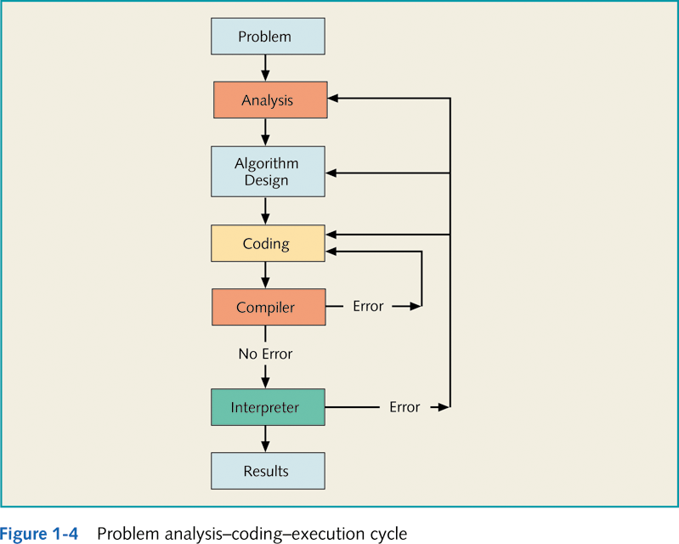
3. Program Solving Cycle (cnt’d)
Syntax Error
Logical or Run-time Error

Slide 10
4. Program Components
A program consists of the following:
Input: Data to begin with to solve the program.
Output: The target of the problem. This is the expected result.
Nouns in the problem statement suggest input and output data.
Processing: This is the set of instructions that drive from the input to the output.
Verbs in the problem suggest the processing steps.
Processing
Input Data
Output Data

Slide 11
Example 1 - Area and Perimeter of a Rectangle
Write a program that calculates the area and the perimeter of a rectangle of width and length 5 cm and 3 cm respectively.
Input
Width = 5 cm
Length = 3 cm
Output
Area = ?
Perimeter = ?
Processing (Input → Output)
Area = length*width = 5 * 3 = 15 cm²
Perimeter = 2*( length + width) = 2*(3 + 5) = 16 cm
If the values of the input data are not given in the problem statement, they may be read from the user through the keyboard.

Slide 12
Example 2 - Area and Perimeter of a Circle
Calculate the area and the perimeter of a circle of radius = 2.5 cm.
Input
Radius = 2.5 cm
PI = 3.14
Output
Area = ?
Perimeter = ?
Processing (Input → Output)
Area = PI * Radius * Radius = 3.14*6.25 = 19.625 cm²
Perimeter = 2 * PI * Radius = 2*3.14*2.5 = 15.7 cm
If the values of the input data are not given in the problem statement, they may be read from the user through the keyboard.

Slide 13
Example 3 - Sum and Average of 5 Numbers
Calculate the sum and the average of the numbers 10, 20, 30, 40 and 50.
Input
Five numbers = x1, x2, x3, x4, x5
Output
Sum = ?
Average = ?
Processing (Input → Output)
Sum = x1+x2+x3+x4+x5 =10+20+30+40+50= 150
Average = Sum/5 = 150/5 = 30
If the values of the input data are not given in the problem statement, they may be read from the user through the keyboard.

Slide 14
5. Introduction to Java (Why Java?)
Java is the world’s most widely used computer programming language.
In use today are more than a billion general- purpose computers and billions more Java-enabled cell phones, smart phones and handheld devices (such as tablet computers).
Java has become the language of choice for implementing Internet-based applications and software for devices that communicate over a network.
Java is Object-Oriented (OO)- today’s key programming methodology.

Slide 15
5.1 History of Java
Developed by Sun Microsystems – a company known for its workstations.
Java is well known for developing internet applications. it is used to :
Create web pages with dynamic and interactive content.
Develop large –scale enterprise applications.
Enhance the functionality of WWW servers .
Provide applications for customer devices (ex. Cell phones)
Java programs can run from a web browser.

Slide 16
5.2 Some Characteristics of Java
Object-Oriented Programming
a program is a collection of interacting objects.
Combines data and behavior into one unit➔ object
Essential for large programs, Analyze program requirements, then develop
Java is Platform-independent
Portable
”Write-once, run-anywhere”
Create program for Graphical User Interface Program
Secure
The bytecode verifier of the JVM :
checks untrusted bytecode
Developing internet applications. it is used to :
Create web pages with dynamic and interactive content.
Develop large –scale enterprise applications.
Provide applications for customer devices (ex. Cell phones)
Dynamic and strong language.

Slide 17
5.3 Java programs
Java programs may be divided into:
Standalone/desktop applications (do not need a web browser to run)
Applets (need a web browser to run)
To write Java programs, you need to download and install the Java Development Kit (JDK), which is a development environment includes tools useful for this purpose.
JDK could be found in various editions.
Java Standard Edition (Java SE)
Java Enterprise Edition (Java EE)
Java Micro Edition (Java ME)

Slide 18
5.4 Java Editions
Java Standard Edition (Java SE)
Used for developing cross-platform, general- purpose applications.
You can download the JDK and its documentation from
www.oracle.com/technetwork/java/javase/downloads/index.html
Java Enterprise Edition (Java EE)
Geared toward developing large-scale, distributed networking applications and web-based applications.
Java Micro Edition (Java ME)
Geared toward developing applications for small, memory-constrained devices, such as BlackBerry smart phones.

Slide 19
6. Java and a Typical Java Development Environment
Java programs normally go through five phases:
Edit:
Using a text editor like Notepad or an(Integrated development environment) IDE like NetBeans to write the program.
Saving the program (source code) in .java file
Compile:
Using the command javac to create a .class file. Which contains the compiled version of the program (Java byte code)
Load: stores bytecodes in memory
Verify: ensures bytecodes do not violate security requirements.
Execute
Using the command java, where Java Virtual Machine (JVM) executes the java byte code in the .class file
You can visit Oracle’s New to Java Center at :
www.oracle.com/technetwork/topics/newtojava/overviewindex.html

Slide 20
6. Typical Java development environment.
Editor
Program is created in an editor and stored on disk in a file ending with .java.
Phase 1
Disk
Phase 2
Compiler
Disk
Compiler creates bytecodes and stores them on disk in a file ending with .class.
Primary
Memory
Java Development Environment
Integrated Development Environment (IDE)
JGrasp
Phase 3
Class Loader
Class loader reads .class files containing bytecodes from disk and puts those bytecodes in memory.
Disk
.
.
.
.
.
.
Primary
Memory
Phase 4
Bytecode Verifier
Bytecode verifier confirms that all bytecodes are valid and do not violate Java’s security restrictions.
.
.
.
.
.
.
Primary
Memory
Phase 5
Interpreter
Interpreter reads bytecodes and translates them into a language that the computer can understand, possibly storing data values as the program executes.
.
.
.
.
.
.

Slide 21
7. Program Compilation
Computers do not understand programs written in high programming languages (source code) such as C++ and Java
Therefore, programs must be converted into machine code that the computer can understand and execute
A software that translates a source code from a high-level programming language into machine code is called a compiler
a.alhomaidhi@psau.edu
Compiler
Source Code
Machine Code

Slide 22
7.1 Program Compilation (cnt’d)
The compiler is a software that checks the correctness of the source code according to the language rules.
If the compiler produces an error, this is called a syntax error.
Translates the source code into a machine code if no errors were found.
Machine code depends on the computer hardware: we say that the compiled version is platform-dependent.
For example, a program compiled on a machine that works under the Windows operating system, cannot run on another machine that works under the MAC operating system.
In this case, the program should be re-compiled under the MAC operating system.
However, Java is characterized by being platform-independent. In other words, a Java program that is compiled under the Windows OS can run under the MAC OS without being re-compiled.
Refer to figure in Slide 20 -23

Slide 23

7.1 Java Programs Compilation(cnt’d)
The Java compiler translates the source code (with extension “.java”) into a bytecode (with extension “.class”) rather than machine code.
Then, a bytecode is converted into machine code using a Java Interpreter.
Source Code
Bytecode
Java VM or JVM = Java Virtual Machine

Slide 24
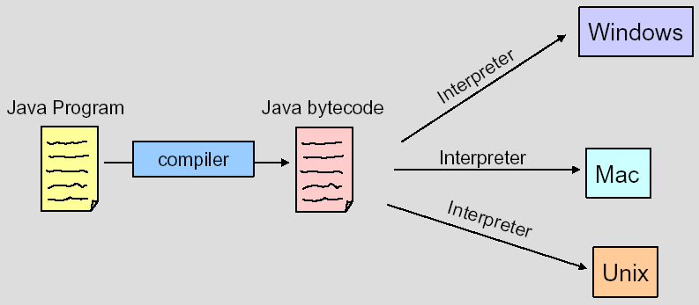
7.1 Java Programs Compilation
You can run bytecode on an computer that has a Java Interpreter installed
“Hello.java”
“Hello.class”

Slide 25
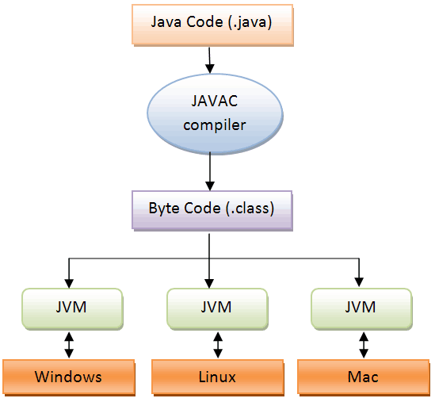
7.1 Java Programs Compilation

Slide 26
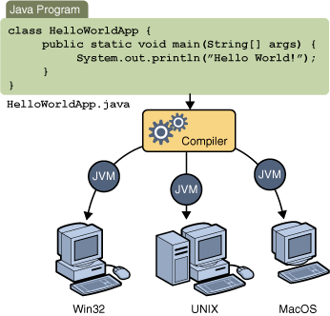
7.1 Java Programs Compilation (cnt’d)
JVM = Java Virtual Machine

Slide 27
7.2 Java Virtual Machine (JVM)
Java Virtual Machine (JVM): A hypothetical computer developed to make Java programs machine independent (i.e. run on many different types of computer platforms).
A JVM consists of the following components:
The class loader: stores the bytecodes into the computer memory
Bytecode verifier: ensures that the bytecodes do not violate security requirements
Bytecode interpreter: translates the bytecode into machine language
Refer to figure in Slide 25

Slide 28
7.2 Java Virtual Machine (JVM) – cnt’d
Class Loader
Bytecode Verifier
Running
Bytecode Interpreter
JVM
The Bytecode
(the “.class” file)
Operating System
Hardware

Slide 29
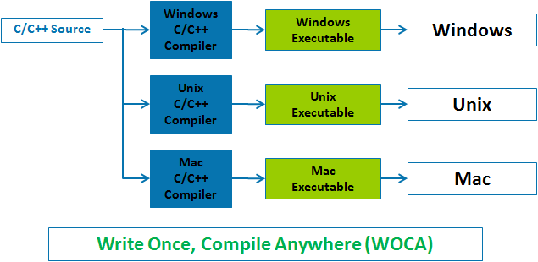
8. Difference between Java and C++

Slide 30
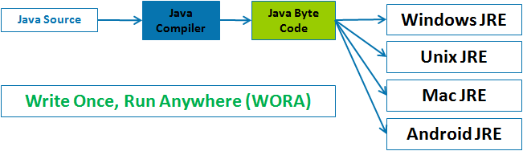
8. Difference between Java and C++

Slide 31
9. Program Testing and Debugging
Testing: After program compilation, the programmer needs to make sure that the output of the program matches the expected results. There are some types of errors:
Syntax errors: are raised if some rules were broken. The Java compiler generates syntax-error messages when the syntax of a program is incorrect. Each error message contains the file name and line number where the error occurred. For example, Welcome1.java:6 indicates that an error occurred in the file Welcome1.java at line 6. The remainder of the error message provides information about the syntax error.
Logical Errors: The program run but provides wrong output.
Runtime errors: The program stop running suddenly when asking the OS executing a non accepted statement (divide by zero, etc).
Compiler errors: The compiler error message “Public class ClassName must be defined in a file called ClassName.java” indicates that the file name does not exactly match the name of the public class in the file or that you typed the class name incorrectly when compiling the class.
Debugging: When an error is encountered, it should be found, understood, and corrected.

Slide 32

Self-Check Exercises
What are the inputs, outputs and processing operations in the following problems:
Convert a temperature from ⁰C into ⁰F.
Find how many seconds are there in a number of minutes? hours?
Specify if a student passes a course or not.
W1.2 Introduction

